Slide 1

20CS63-SERVER-SIDE SCRIPTING LAB
DEPARTMENT OF COMPUTER SCIENCE & ENGINEERING
B.TECH VI SEM

Slide 2
The scripts may be created in two ways: on the client side or the server side, where the server-side scripts are processed on a server.
In contrast, client-side scripting needs browsers to execute scripts on the client system but doesn't connect with the server executing the client-side scripts.

Slide 3
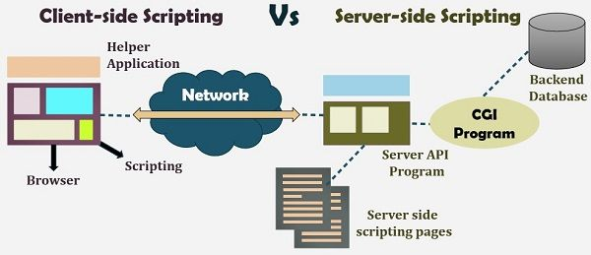

Slide 4
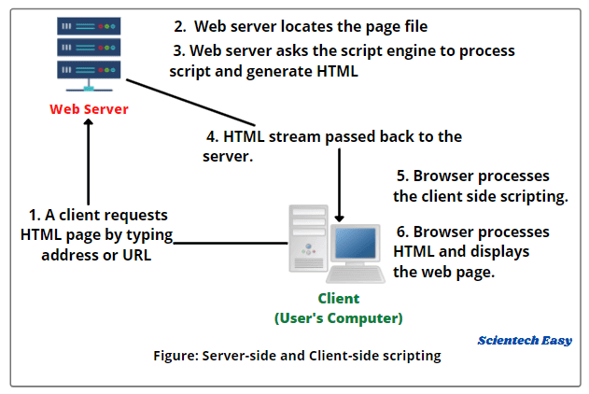

Slide 5
What is Client-side Scripting?
Client-side scripting generates code that may be executed on the client end without needing server-side processing.
These scripts are typically embedded into HTML text.
Client-side scripting may be utilized to check the user's form for problems before submitting it and to change the content based on the user input.
The web needs three components to function: client, database, and server.
The client-side scripting may significantly reduce server demand.
It is intended to be utilized as a scripting language with a web browser as the host program.
The HTML and CSS are delivered as plain text when a user uses a browser to request a webpage from the server, and the browser understands and renders the web content at the client end.

Slide 6
Client-side Scripting Languages
There are various client-side scripting languages. Some main client-side scripting languages are as follows:
HTML –Designing
CSS – application's appearance look more stylish
JavaScript – Simple Validations & Calculations
VBScript - VBScript is based on Visual Basic, which was created by
Microsoft in 1996. It is a scripting programming
language that is lightweight, fast, and easy to learn. It is
not a OOPs language but is similar to JavaScript.

Slide 7
Features of Client-side Scripting:
There are various features of client-side scripting. Some main features of the client-side scripting are as follows:
It is intended to execute code on which a web browser runs, and the results of the inputs are delivered to an accessible user.
Client-side scripting enables greater involvement with clients via the browser and is used to validate programs and functionality based on the request.
The client does not include any contact with the server in client-side scripting; the only interaction is receiving the requested data.

Slide 8
What is Server-side Scripting?
Server-side scripting is a programming technique for creating code that may run software on the server side.
At the server end, actions such as website customization, dynamic changes in website content, response creation to user requests, database access, and many more are carried out.
Server-side scripting creates a communication channel between a server and a client.
Previously, CGI (Common Gateway Interface) scripts were used to implement server-side scripting, and CGI was created to execute scripts written in computer languages such as C++ or Perl on websites.
The server-side is made up of three parts: the database, the server, the APIs, and the backend web software written in the server-side scripting language.

Slide 9
Server-side scripting languages:
There are various server-side scripting languages. Some main server-side scripting languages are as follows:
Python - It is an open-source language that is very powerful and easy to
learn. It is suitable for beginners because it is simple to learn and
read.
PHP - It is an open-source server-side scripting programming language
mainly designed for web apps and is the most utilized scripting
language.
Ruby - It is a free and open-source programming language that was
developed and firstly introduced in the early 1990s.

Slide 10
Features of Server-side Scripting
There are various features of server-side scripting. Some main features of the server-side scripting are as follows:
It is connected with data access, error handling, and data processing speed.
It is processed and interacts with the server.
Using a highly integrated programming language makes it more secure than client-side scripting.

Slide 11
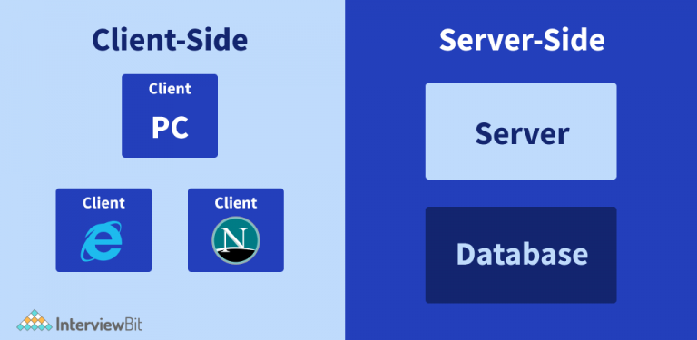
Difference between Client-Side Scripting and Server-Side Scripting

Slide 12
JSP Example:
<%@page language="java" import="java.util.*"%>
<html>
<head>
<title>Sample JSP Page</title>
</head>
<body>
<%! Date dt=new Date();%>
<b>Now! The Time is</b>
<%=dt.getHours()%>:<%=dt.getMinutes()%>:<%=dt.getSeconds()%>
</body>
</html>

Slide 13
HTML CODE
<html>
<head>
<tittle>Sample HTML </title>
<script type="text/javascript">
function display()
{
var dt=new Date();
document.getElementById(“tm").innerHTML=dt.getHours()+":"+dt.getMinutes()+":"+dt.getSeconds();
}
</script>
</head>
<body onLoad=display()>
<p id=“tm"></p></body></html>

Slide 14
PHP CODE
<html>
<body>
<?php
echo "Today is " . date("h:i:sa") . "<br>";
echo "Today is " . date("Y.m.d") . "<br>";
echo "Today is " . date("Y-m-d") . "<br>";
echo "Today is " . date("l");
?>
</body>
</html>

